Slide 1

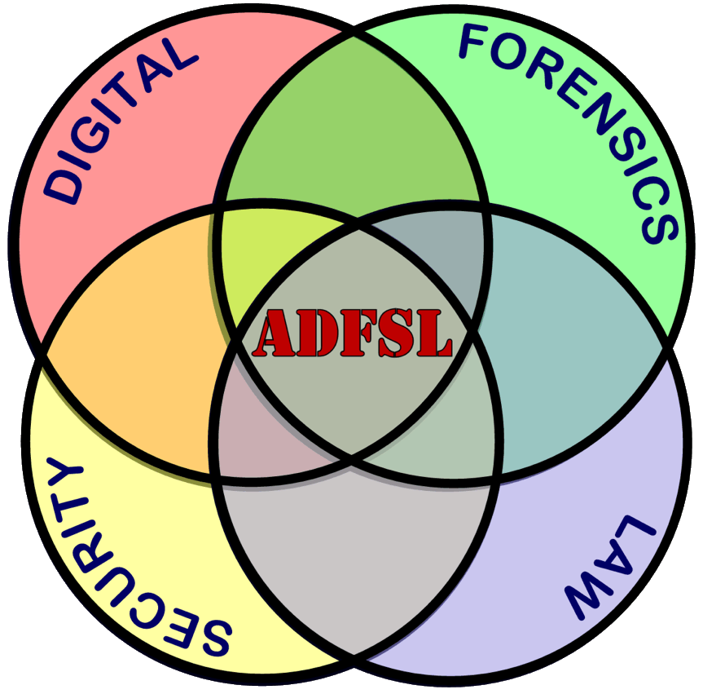

MemoryRanger Prevents Hijacking FILE_OBJECT structures in Windows Kernel
Igor Korkin
2019 ADFSL Conference
Notes:
Hi! I’m Igor!
Thanks for coming! Today I’ll present you how some Windows components such as the Security Reference Monitor and the Object Manager can be attacked and how to prevent these kinds of attacks using my MemoryRanger.

Slide 2

WHOAMI
MEPhI Alumni, PhD in Cyber Security
Area of interest is Windows Kernel security:
Memory Forensics
Rootkits Detection
Bare-Metal Hypervisors
Fan of cross-disciplinary research - igorkorkin.blogspot.com
Love traveling and powerlifting - igor.korkin
Notes:
That’s my 6-th time here at the ADFSL conference and I’m very happy to be in Florida again.
In my research I am focused on operating system security and most of /ov/ all on Windows Kernel Security.
You can find my results in my blog. Also, I am fond of travelling and powerlifting as well.

Slide 3
Agenda
Notes:
Our talk will have three parts.

Slide 4
Agenda
FILE_OBJECT hijacking: details and demo
Notes:
Firstly, I’ll show you how to áccess the content of file, which has been opened without sharing access.
This new attack on kernel memory does not trigger any protection mechanisms.

Slide 5
Agenda
FILE_OBJECT hijacking: details and demo
A history of related OS components and memory protection issues
Notes:
Secondly, I’ll present you a brief history of memory protection issues.

Slide 6
Agenda
FILE_OBJECT hijacking: details and demo
A history of related OS components and memory protection issues
MemoryRanger hypervisor protects sensitive kernel memory
Notes:
Finally, I am going to demonstrate how this problem can be solved by my MemoryRanger.
MemoryRanger is a hypervisor /ˈhaɪpə(r)ˌ vaɪzə(r)/ , which protects memory by running drivers inside the isolated /ˈaɪsəˌleɪtɪd/ kernel spaces.

Slide 7
Agenda
FILE_OBJECT hijacking: details and demo
A history of related OS components and memory protection issues
MemoryRanger hypervisor protects sensitive kernel memory
Notes:
Last year I presented my MemoryRanger at the Black Hat Europe.
Today’s presentation demonstrates its further development.
Feel frée to ask me any questions at the end of our talk.

Slide 8
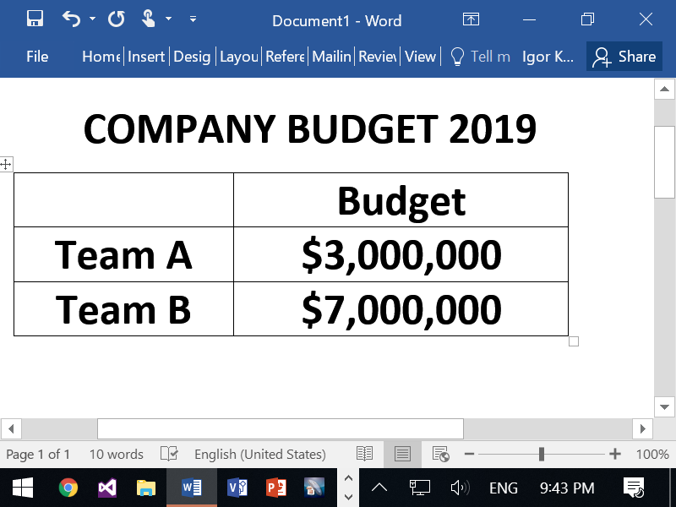
File Manager in Kernel Mode
Notes:
Let’s imagine the following situation.
The big boss is sitting in front /frʌnt/ of his computer and is drawing up a budget.
We can see it on the screen.

Slide 9

Notes:
Of course, the boss doesn’t want to share the budget with anyone and so he opens the budget file without sharing access.

Slide 10
ZwCreateFile routine
NTSTATUS ZwCreateFile(..., ShareAccess, ...);
Notes:
To create such a file in kernel mode he uses function ZwCreateFile.
It has 10 parameters, one of them is ShareAccess,

Slide 11
ZwCreateFile routine
NTSTATUS ZwCreateFile(..., ShareAccess, ...);
ShareAccess
ShareAccess flag determines whether other drivers can access the opened file.
Calling ZwCreateFile with ShareAccess=0 gives the caller exclusive access to the file.
Notes:
which determines whether other drivers can read or modify this file.
Drivers usually set ShareAccess to zero, which gives the user exclusive access to the open file.

Slide 12


Notes:
Here is the “hacker-attacker” plotting to snoop /snuːp/ (I mean read /riːd/ ) and modify the boss’s budget.

Slide 13
Notes:
Mícrosóft guarantees that the user gets an exclusive access to the open file and all other access attempts will fail.

Slide 14
Notes:
However, the attacker can overcome this barrier and gain the access to the budget. I’ll show you how.

Slide 15
file system routines in Windows kernel
Notes:
Let’s have a look at the details of file system routines in Windows kernel.
Drivers use ZwCreateFile routine to create or open a file on the disk.
What happens after the driver calls this routine?

Slide 16
file system routines in Windows kernel
Notes:
This function involves an Iee/Oou Manager,

Slide 17
file system routines in Windows kernel
Notes:
Object Manager

Slide 18
file system routines in Windows kernel
Notes:
Security Reference Monitor

Slide 19
file system routines in Windows kernel
Notes:
and then the control goes to the file system drivers that create the file on the disk.
The most important component is the Security Reference Monitor,

Slide 20
file system routines in Windows kernel
Notes:
which is in charge of the access validation. It processes the files request and gains or blocks an access to the file. Security Reference Monitor collects and checks file permissions using its Access Control List.

Slide 21
file system routines in Windows kernel
Notes:
For example, if the file is created without sharing access or in an exclusive mode.

Slide 22
file system routines in Windows kernel
Notes:
All other access attempts to open this file fail {pause} because they cause the conflict with the sharing mode of an existing file handle. In that situation Security Reference Monitor returns the status /ˈsteɪtəs/ sharing violation. ZwCreateFile routine always involves Security Reference Monitor, which prevents illegal access to the files, that are opened at the moment.

Slide 23
file system routines in Windows kernel
Notes:
Well. After Security Reference Monitor allows /əˈlaʊz/ access, the Object Manager creates {pause} a fíle hándle and a FILE_ÓBJECT. That FILE_OBJECT structure is the internal ánalógue /ˈænəˌlɒɡ/ of the file handle, which is used as a parameter in read and write functions.

Slide 24
file system routines in Windows kernel
Notes:
The functions ZwReadFile and ZwWriteFile access the file using the already created FILE_OBJECT structure. The key point is that they do not involve any security checks. Read and write file operations are processing without calling Security Reference Monitor.
The attacker can use this (so-called) zero-day vulnerability /ˌvʌln(ə)rəˈbɪləti/ to compromise the open budget file in the following way.

Slide 25
file system routines in Windows kernel
Notes:
Here is the hypothetical attacker.

Slide 26
file system routines in Windows kernel
Notes:
Firstly, he can create a new file using ZwCreateFile. We call it the “file hijacker”.
OS returns the corresponding file handle to the attacker.
Next attacker can locate its FILE_OBJECT structure and the budget FILE_OBJECT structure, which is related to the budget file.

Slide 27
file system routines in Windows kernel
Notes:
Secondly, the attacker can copy the budget FILE_OBJECT to the FILE_OBJECT of the file hijacker.
Let me call it the hijacking attack.

Slide 28
file system routines in Windows kernel
Notes:
And now all read and write operations to the file hijacker are redirected to the budget file.
As a result, using the file hijacker handle, the attacker will be able to read and modify the budget file using functions ZwReadFile and ZwWriteFile. Now let’s move on to the FILE_OBJECT details.

Slide 29
Just 4 crucial fields for FILES hijacking
typedef struct _FILE_OBJECT { … PVPB Vpb; PVOID FsContext; PVOID FsContext2; PSECTION_OBJECT_POINTERS SectionObjectPointer; … } FILE_OBJECT;
The Vpb field points to a mounted Volume Parameter Block (VPB), associated with the target device object.
FsContext points to the FSRTL_COMMON_FCB_HEADER structure, which has to be allocated by the file driver.
FsContext2 field refers to the Context Control Block (CBB) associated with the file object
SectionObjectPointer stores file-mapping and caching-related information for a file stream.
Notes:
The FILE_OBJECT is a kernel-mode structure that represents an open file.
It includes 30 thirty data fields and is documented in the Windows Drivers Kit.
In my experience drivers usually do not read or modify the fields of FILE_OBJECT structure.
But in this research, I did read and did modify those fields.
The thing is that just by copying the following four data fields from the budget FILE_OBJECT the attacker can read and modify the budget file. Let’s see how it can happen.

Slide 30
THE attack
Notes:
I’ll show the following scenario.
The boss will create a budget file in an exclusive mode and will draw up the budget.
After that, the attacker’s driver will try to access the budget file. The attacker will try to access the budget file twice. First, by calling ZwCreateFile routine

Slide 31
THE attack
Notes:
and second by using the proposed hijacking attack.
To manipulate /məˈnɪpjʊleɪt/ with files from kernel-mode I will use drivers.
The input data will be sent to these drivers using the corresponding user-mode console apps. Let’s see!

Slide 32
Demo: The Attack
The online version is here – https://www.youtube.com/watch?v=2mU85RluOSA?vq=hd1080
Notes:
The boss is launching his console, which loads a driver.
By using f_open he creates an empty budget file in the current folder.
Windows creates the file handle and allocates the FILE_OBJECT structure.
By using f_write the boss is setting up the budget.
Now, the boss is checking the budget. Done.
The boss is talking on the phone and the budget file remains open.
At this moment, the attacker has got a chance to snoop the budget.
He is launching its console. He is calling file system routine ZwCreateFile to open the budget.
So, he fails to open the file. Windows returns the status sharing violation.
Windows prevents illegal access to the budget file.
But the attacker keeps trying to gain the access.
He is copying the address of the FILE_OBJECT to run the hijacking attack.
By using f_open_by_hijacking the attacker creates a file hijacker.
Windows returns the corresponding file handle and FILE_OBJECT.
After that the attacker copies the budget FILE_OBJECT into the allocated FILE_OBJECT structure.
Now, the attacker is reading the file hijacker. And we can see that the budget is revealed, it is not a secret anymore.
The attacker is coping the content in order to modify it.
The attacker is overwriting the budget file by replacing the data.
And now if the boss decides to check his budget, he will see some illegal changes.
But let’s wait for PatchGuard reaction, which is designed to prevent such illegal memory modifications.
Usually PatchGuard crashes the OS in less than one hour.
We’ve been waiting for 8 hours it is quite a long time but nothing has happened.
The OS has not been crushed.
It means that PatchGuard fails and the OS is unable to guarantee an exclusive access.
The system is not protected.

Slide 33
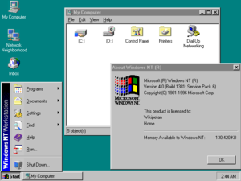
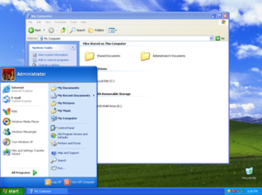
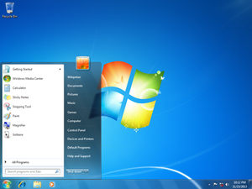
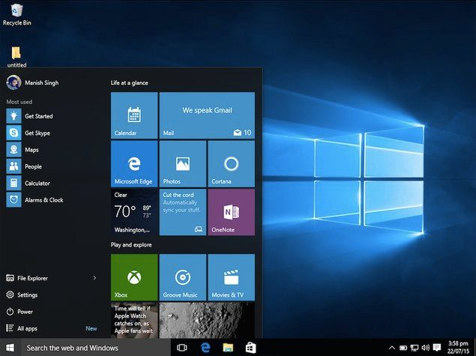
The Analysis of the attack
All Windows OSes since NT 4.0 are vulnerable for FILE_OBJECT hijacking:
Notes:
Let’s try to analyze this attack and try to find some possible ways to prevent it.
First, this attack exploits the fundamental weaknesses of some Windows components, which have not been changed for years.
It means, that all Windows OSes since NT 4.0 are vulnerable to this attack, even the newest Windows 10.

Slide 34
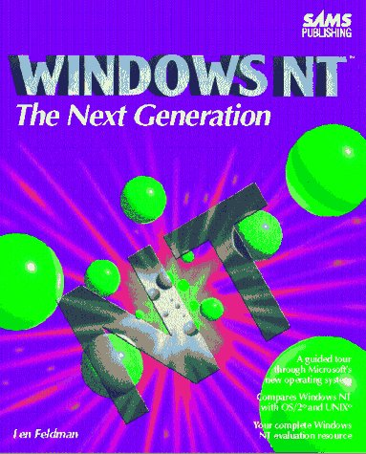
The Analysis of the attack
All Windows OSes since NT 4.0 are vulnerable for FILE_OBJECT hijacking:
1993 - the first mention of Object Manager and Security Reference Monitor
Windows NT: The Next Generation
by Len Feldman, March 1, 1993
Notes:
Moreover, I managed to buy a book, which was the first that described the Security Reference Monitor and the Object Manager. So, the attack we are talking about is applicable since 1993 and this is one of the oldest vulnerabilities /ˌvʌln(ə)rəˈbɪlətis/ ever found.
When I found this vulnerability, I felt like an archeologist, who had revealed a new ancient artefact.
But, {big-pause} the challenge of memory protection is much much older.

Slide 35
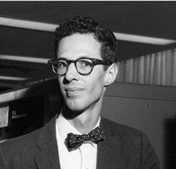
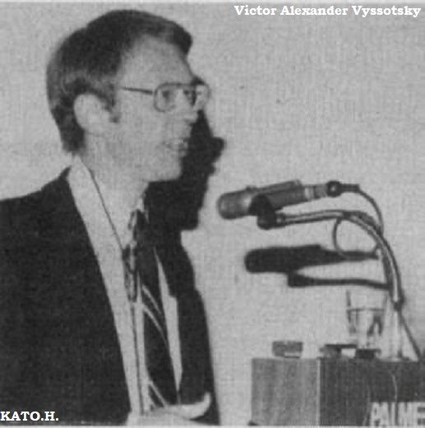
The Analysis of the attack
All Windows OSes since NT 4.0 are vulnerable for FILE_OBJECT hijacking:
1993 - the first mention of Object Manager and Security Reference Monitor
1965 – the first memory isolation concept Multics* was developed for General Electric 645 mainframe. Multics joined to the ARPANet and gave rise to the Unix.
Two Fathers of Multics
Fernando Corbato
Victor Vyssotsky
*DOI: http://dx.doi.org/10.1145/1463891.1463912
Notes:
The very first mention of the illegal memory access and ways of preventing them dates back to 1965.
Multics system was developed to isolate memory. You can see that authors of Multics were focused on memory protection for General Electric mainframes. That was the first generation of mainframes and they already had security problems. Could you imagine that a half-century has passed and little has changed? And we still have this problem with memory access restriction.

Slide 36
The FILE_OBJECT protection via encryption
Notes:
So, let’s go back to nowadays and think how can we protect FILE_OBJECT structures?

Slide 37
The FILE_OBJECT protection via encryption
Notes:
To provide confidentiality we usually apply encryption.

Slide 38
The FILE_OBJECT protection via encryption
Encrypt the FILE_OBJECT
Notes:
But {-pause-} the problem is that these structures are allocated dynamically. To protect FILE_OBJECT we need to encrypt their content.

Slide 39
The FILE_OBJECT protection via encryption
Encrypt the FILE_OBJECT
Trap legal access
Notes:
Next, we need to trap any access to this memory

Slide 40
The FILE_OBJECT protection via encryption
Encrypt the FILE_OBJECT
Trap legal access
Decrypt the FILE_OBJECT
Notes:
in order to decrypt its content, allow /əˈlaʊ/ access,

Slide 41
The FILE_OBJECT protection via encryption
Encrypt the FILE_OBJECT
Trap legal access
Decrypt the FILE_OBJECT
Wait to complete file operation
Notes:
wait until the file operation is completed,

Slide 42
The FILE_OBJECT protection via encryption
Encrypt the FILE_OBJECT
Trap legal access
Decrypt the FILE_OBJECT
Wait to complete file operation
Go to step 1
Notes:
and encrypt FILE_OBJECT again. We need to repeat these steps

Slide 43
The FILE_OBJECT protection via encryption
Encrypt the FILE_OBJECT
Trap legal access
Decrypt the FILE_OBJECT
Wait file operation completion
Go to step 1
Encrypt the FILE_OBJECT
Trap legal access
Decrypt the FILE_OBJECT
Wait file operation completion
Go to step 1
Encrypt the FILE_OBJECT
Trap legal access
Decrypt the FILE_OBJECT
Wait file operation completion
Go to step 1
Encrypt the FILE_OBJECT
Trap legal access
Decrypt the FILE_OBJECT
Wait file operation completion
Go to step 1
Encrypt the FILE_OBJECT
Trap legal access
Decrypt the FILE_OBJECT
Wait to complete file operation
Go to step 1
Notes:
for each read and write operation and for each file.
And it is absolutely obvious that, such encryption will cause huge

Slide 44

The FILE_OBJECT protection via encryption
Encrypt the FILE_OBJECT
Trap legal access
Decrypt the FILE_OBJECT
Wait file operation completion
Go to step 1
Encrypt the FILE_OBJECT
Trap legal access
Decrypt the FILE_OBJECT
Wait file operation completion
Go to step 1
Encrypt the FILE_OBJECT
Trap legal access
Decrypt the FILE_OBJECT
Wait file operation completion
Go to step 1
Encrypt the FILE_OBJECT
Trap legal access
Decrypt the FILE_OBJECT
Wait file operation completion
Go to step 1
Encrypt the FILE_OBJECT
Trap legal access
Decrypt the FILE_OBJECT
Wait to complete file operation
Go to step 1
Notes:
performance degradation

Slide 45
Windows kernel memory
Notes:
I think the main problem of Windows kernel security is that all drivers and OS kernel

Slide 46
Windows kernel memory
Notes:
share the same memory space.

Slide 47
Windows kernel memory
Notes:
If we could move these three drivers into three isolated memory enclosures, we would protect their memory from each other.

Slide 48
Windows kernel memory
Notes:
But, the thing is that Windows OS doesn’t give us such an opportunity

Slide 49
Processing memory access: EPT feature
VT-x without EPT
Paging structures
Guest OS
Hypervisor
Host Memory
Notes:
Luckily for us, hardware virtualization technology provídes the mechanism, which can be used to implement the idea of memory ísolátion /ˌaɪsəˈleɪʃ(ə)n/.
I mean Extended Page Tables or EPT feature.

Slide 50
Processing memory access: EPT feature
VT-x without EPT
Guest Virtual Address
Guest Physical Address
V
Paging structures
Guest OS
G
Hypervisor
Host Memory
Host Physical Address
H
=
G
Notes:
Without EPT guest physical addrésses are used to access the host physical memory. Address H is equal to the address G.

Slide 51

Processing memory access: EPT feature
VT-x without EPT
VT-x with EPT
Guest Virtual Address
Guest Physical Address
V
Paging structures
Paging structures
Guest OS
G
EPT Paging structures
Hypervisor
Host Memory
Host Physical Address
H
=
G
Notes:
Using EPT we can get an additional or second level of address translation. When EPT is enabled, guest physical addresses are translated to host physical addrésses by traversing a set of EPT paging structures.

Slide 52
Processing memory access: EPT feature
VT-x without EPT
VT-x with EPT
Guest Virtual Address
Guest Virtual Address
Guest Physical Address
Guest Physical Address
V
V
Paging structures
Paging structures
Guest OS
G
G
EPT Paging structures
Hypervisor
EPT Physical Address
EPT( )
G
Host Memory
Host Physical Address
Host Physical Address
=
=
H
G
H
=EPT( )
G
Notes:
Now, address H is calculated using EPT mechanism. Let’s have a look at the EèePèeTèe details.

Slide 53
EPT Paging structures
EPT Paging structures
EPT Tables
EPT Tables
EPT Page Table Entries
EPT Entry for the Page A
EPT Entry for the Page B
…
EPT Entry for the Page Z
Notes:
The key component of EPT mechanism is the set of EPT paging structures.
These structures include EPT entries, which determine

Slide 54
EPT Paging structures
EPT Paging structures
Page A
Guest Physical Address
EPT Tables
EPT Tables
EPT Page Table Entries
Page A
Host Physical Address
EPT Entry for the Page A
EPT Entry for the Page B
…
EPT Entry for the Page Z
Notes:
the mapping between the guest memory and the host memory. Let’s see how we can apply EPT.

Slide 55
EPT main features
Using EPT we can trap read/write/execute access attempts and redirect them from the secret page to the fake one:
Notes:
First, EPT can help to control read, write and even execute access for each memory page.

Slide 56
EPT main features
Using EPT we can trap read/write/execute access attempts and redirect them from the secret page to the fake one:
access
Guest Page
Host Page
Hypervisor does not react
Notes:
For example, to trap any read access to the sensitive data

Slide 57
EPT main features
Using EPT we can trap read/write/execute access attempts and redirect them from the secret page to the fake one:
access
access
Guest Page
Host Page
Guest Page
Host Page
Hypervisor does not react
Hypervisor traps all these access attempts
Notes:
we set to the zero the corresponding access bits on page with this data.
Also, after trapping such access attempts,

Slide 58
EPT main features
Using EPT we can trap read/write/execute access attempts and redirect them from the secret page to the fake one:
access
access
Guest Page
Host Page
Guest Page
Host Page
Hypervisor does not react
Hypervisor traps all these access attempts
Notes:
we can redirect /ˌriːdɪˈrekt/ them from the secret page to the new memory page a page with fake data.

Slide 59
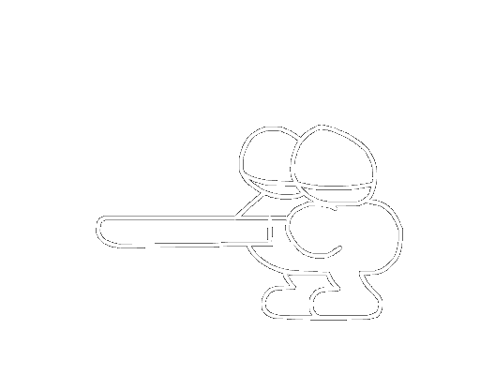
EPT main features
Using EPT we can trap read/write/execute access attempts and redirect them from the secret page to the fake one:
access
access
Guest Page
Host Page
Guest Page
Host Page
Hypervisor does not react
Hypervisor traps all these access attempts
Notes:
a page with fake data

Slide 60
EPT main features
Using EPT we can trap read/write/execute access attempts and redirect them from the secret page to the fake one:
EPT memory settings can be updated in the real time
access
access
Guest Page
Host Page
Guest Page
Host Page
Fake Page
Hypervisor does not react
Hypervisor traps all these access attempts
Notes:
Second, these /ðiːz/ memory access permissions and redirected confígurátions /kənˌfɪɡjəˈreɪʃ(ə)nz/ can be changed in real time. So, we can dynamically restrict access to any memory regions using one set of EPT paging structures.

Slide 61
EPT main features
Using EPT we can trap read/write/execute access attempts and redirect them from the secret page to the fake one:
EPT memory settings can be updated in the real time
We can dynamically allocate several EPTs with different memory setting and switch between them in the real time
access
access
Guest Page
Host Page
Guest Page
Host Page
Fake Page
Hypervisor does not react
Hypervisor traps all these access attempts
Notes:
Finally, we can állocáte /ˈæləkeɪt/ several sets of EPT paging structures with various memory access confígurátions /kənˌfɪɡjəˈreɪʃ(ə)nz/. And by switching between them, we can organize drivers’ execution in ìsolated enclaves. That’s exactly what we need.

Slide 62
Windows kernel memory
Notes:
The main idea of MemoryRanger

Slide 63
Windows kernel memory
Notes:
is to /ˈsepəreɪt/ séparáte drivers in that way, so all drivers will be executed in isolated memory enclosures.
Let me show you how to implement this idea to protect FILE_OBJECT structures.

Slide 64
memory ranger prevents file_object hijacking
Notes:
I explored the following scenario. The OS kernel is loaded into the memory and accesses its data.

Slide 65
memory ranger prevents file_object hijacking
Notes:
After that the boss loads its driver, and opens the budget file.
You can see the corresponding FILE_OBJECT structure.

Slide 66
memory ranger prevents file_object hijacking
Notes:
Next the attacker’s driver is loaded and it creates the file hijacker.

Slide 67
memory ranger prevents file_object hijacking
Notes:
Also, the attacker tries to access the budget FILE_OBJECT structure in order to reveal it.
As you remember that all drivers share the same memory space and such an illegal access attempt is becoming uncontrolled.
Let’s roll back and launch my MemoryRanger to isolate all these drivers from the rest of the OS kernel.

Slide 68
memory ranger prevents file_object hijacking
Notes:
First of all, MemoryRanger allocates the EPT structure for the default enclave.
Windows OS kernel is executed inside the default enclave.

Slide 69
memory ranger prevents file_object hijacking
Notes:
Next, MemoryRanger traps the loading of the boss’s /bɒses/ driver and allocates a new EPT structure for the boss’s enclave.
MemoryRanger updates all EPT structures in the following way.
Only boss’s driver and OS kernel are executed inside boss’s enclave.
In the default enclave, MemoryRanger restricts access to the boss’s driver.
This memory access confígurátion /kənˌfɪɡjəˈreɪʃ(ə)n/ guarantees that the boss’s driver is executed inside its enclave only.

Slide 70
memory ranger prevents file_object hijacking
Notes:
The boss’s driver creates a budget file, the OS allocates the corresponding FILE_OBJECT structure.
My MemoryRanger updates all enclaves’ /kənˌfɪɡjəˈreɪʃ(ə)nz/ confígurátions again.
As a result, the boss’s driver áccessés the budget only inside its enclave.
MemoryRanger traps /træps/ the loading of the attacker’s driver

Slide 71
memory ranger prevents file_object hijacking
Notes:
and creates an enclave for it.
You can see that the attacker’s driver can be executed only inside its own enclave, where the budget FILE_OBJECT structure is protected. The boss’s driver is protected as well.

Slide 72
memory ranger prevents file_object hijacking
Notes:
Then the attacker’s driver creates the file hijacker.
MemoryRanger traps this event as well and updates all enclaves’ /kənˌfɪɡjəˈreɪʃ(ə)nz/ confígurátions again.

Slide 73
memory ranger prevents file_object hijacking
Notes:
Finally, the attacker’s driver tries to read the FILE_OBJECT structure of the budget file.
This event causes EPT memory violation, which is processed by my MemoryRanger.

Slide 74

memory ranger prevents file_object hijacking
Notes:
MemoryRanger is foisting the fake page on the attacker instead of the real one.
In the same way, MemoryRanger allocates a separate EPT structure or memory enclave for each newly loaded driver and updates all other enclaves. This is the main idea. Let’s move on to the demonstration.

Slide 75
Demo: Preventing the hijacking
Notes:
The boss will load its driver to draw up the budget. After that, the attacker’s driver will be loaded in order to hijack the budget.

Slide 76
Demo: Preventing the hijacking
Notes:
Let’s have a look what will happen if I launch MemoryRanger befo-o-re.

Slide 77
Demo: The Attack Prevention
The online version is here – https://www.youtube.com/watch?v=8ONmC5Do4I4?vq=hd1080
Notes:
First of all, we are launching MemoryRanger console application.
It loads the hypervisor /ˈhaɪpə(r)ˌ vaɪzə(r)/ to protect kernel memory.
Then, the boss is launching his console, which loads a driver. The boss creates the budget file.
And we can see the created the file handle and the allocated FILE_OBJECT structure.
By using f_write the boss is setting up the budget.
Now, the boss is checking the budget. Done.
Now the boss receives a call and the budget file remains open.
At this moment, the attacker is getting a chance to snoop the budget.
He is launching its console. He is trying to open the budget using file system routine ZwCreateFile.
So, he fails to open the file, because Windows prevents illegal access to the budget file.
The attacker is willing to gain an access by hijacking.
He copies the address of the FILE_OBJECT. By using f_open_by_hijacking the attacker creates a file hijacker. Windows creates this file and returns the file handle and the FILE_OBJECT structure.
The attacker is trying to read the budget FILE_OBJECT, but he fails.
MemoryRanger prevents illegal memory access to the budget FILE_OBJECT.
Anyway, the attacker is still hoping to read the budget.
But instead of reading a real budget, the attacker can read only the deliberately foisted fake {pause} null data.
He fails again.
But anyway, he is trying to overwrite the budget file.
If the boss decides to check his budget he will see the originals data.
MemoryRanger prevents all illegal access attempts to the budget.
Finally, let’s compare these /ðiːz/ two files. We close the budget file and the file hijacker and both control consoles as well.
We can see that the budget file includes only the budget and all attackers input data is in his file.
The OS is protected.

Slide 78
Demo: Preventing the hijacking
Notes:
So, at the begging we see that situation. Without MemoryRanger, the attacker can access FILE_OBJECT structure without any issues.

Slide 79
Demo: Preventing the hijacking
Notes:
Here you can see the difference between Windows without MemoryRanger and wíth it.
MemoryRanger prevents illegal memory access by running drivers into ísoláted kernel enclosures /ɪnˈkləʊʒə(r)z/.
MemoryRanger traps and controls memory access attempts to the sensitive data.

Slide 80
Notes:
Here is the detailed scheme /skiːm/ , after two drivers have been loaded.
MemoryRanger step-by-step allocates three memory enclosures for the OS kernel, for the boss’s driver, and finally for the attacker’s driver. That scheme helps to intercept and prevent illegal memory access attempts. Actually, it looks very similar with the scheme, which was proposed in the paper from 1965.
Now let’s move on to the MemoryRanger architecture.

Slide 81
Memory Ranger architecture
Notes:
We need to process the following three events:

Slide 82
Memory Ranger architecture
Notes:
loading of a new driver

Slide 83
Memory Ranger architecture
Notes:
calling kernel API functions

Slide 84
Memory Ranger architecture
Notes:
and processing memory access violations, which occur due to the access to the memory with restricted access.

Slide 85
Memory Ranger architecture
Notes:
After a new driver has been loaded MemoryRanger needs to create an enclave for it and updates memory access configurations. The information about the newly created enclave is saved into ISOLATE_MEM_ENCLAVE structure. To be notified whenever a new driver is loaded MemoryRanger uses the callback routine.

Slide 86
Memory Ranger architecture
Notes:
After trapping kernel functions such as ZwCreateFile MemoryRanger locates the created FILE_OBJECT structure and modifies the corresponding memory access permission. The information about the protected memory regions is saved into PROTECTED_MEMORY structures. To hook these routines, MemoryRanger leverages DdiMon component. This component can trap any kernel API function transparently for the OS.

Slide 87
Memory Ranger architecture
Notes:
The third component is MemoryMonRWX, which is able to track and trap all types of memory access: read, write, and execute. MemoryMonRWX processes EPT violations. Execute violation means that it is time to change enclaves so another driver will continue its execution inside its enclave. Read or write violation means that this access is illegal and MemoryMonRWX redirects this violation to the Memory Access Policy.

Slide 88
Memory Ranger architecture
Notes:
Memory Access Policy (MAP) plays a role of an intermediary during memory access to the protected data and decides whether to block or allow this access. Memory Access Policy relies on the ISOLATE_MEM_ENCLAVE structures and PROTECTED_MEMORY structures.
Now let’s move on to the benchmark assessment.

Slide 89
Memory Ranger benchmarks: memory access time
Driver
Protected Memory
Reads/Writes
Notes:
☺ I measured the time of legal access from the driver to the protected data in four situations.

Slide 90
Memory Ranger benchmarks: memory access time
Driver
Protected Memory
Reads/Writes
Notes:
without memory protection with enabled cache,

Slide 91
Memory Ranger benchmarks: memory access time
Driver
Protected Memory
Reads/Writes
Notes:
with disabled cache, and with two memory protectors:

Slide 92
Memory Ranger benchmarks: memory access time
Driver
Protected Memory
Reads/Writes
*
* AllMemPro details - http://bit.ly/AllMemPro
Notes:
AllMemPro

Slide 93
Memory Ranger benchmarks: memory access time
Driver
Protected Memory
Reads/Writes
*
* AllMemPro details - http://bit.ly/AllMemPro
Notes:
and MemoryRanger.

Slide 94
Memory Ranger benchmarks: memory access time
Driver
Protected Memory
Reads/Writes
*
* AllMemPro details - http://bit.ly/AllMemPro
Notes:
AllMemPro or Allocated Memory Protector is the closest competitor for MemoryRanger, which I developed a year ago and presented at the previous ADFSL conference in Texas. AllMemPro uses only one EPT structure to prevent illegal access to the allocated memory.

Slide 95
Memory Ranger benchmarks: memory access time
Driver
Protected Memory
Reads/Writes
*
* AllMemPro details - http://bit.ly/AllMemPro
Notes:
We can conclude that MemoryRanger is a bit slower than access to the memory with disabled cache and it three times faster than the closest competitor.

Slide 96
The current situation with Attacks on windows memory
Notes:
So let’s briefly go for the sensitive memory areas, which can be used during cyber-attacks.

Slide 97
The current situation with Attacks on windows memory
Notes:
Here we have the third-party drivers

Slide 98
The current situation with Attacks on windows memory
Notes:
and OS kernel code.

Slide 99
The current situation with Attacks on windows memory
Notes:
Device Guard provides the integrity for all code sections. But Windows does not provide the code confidentiality.

Slide 100
The current situation with Attacks on windows memory
Notes:
MemoryRanger fills this gap.

Slide 101
The current situation with Attacks on windows memory
Notes:
Next, we have allocated data by the third-party drivers. Windows does not protect that memory.

Slide 102
The current situation with Attacks on windows memory
Notes:
My MemoryRanger can fill both these gaps as well.

Slide 103
The current situation with Attacks on windows memory
Notes:
Now, let’s move on to the internal allocated memory.

Slide 104
The current situation with Attacks on windows memory
Notes:
I do not think, that their confidentiality is really needed, so let’s skip it.

Slide 105
The current situation with Attacks on windows memory
Notes:
PatchGuard provides the integrity of these internal data regions, but only partially.
For example, PatchGuard does not protect EPROCESS structures completely.
It prevents hiding process by checking the PsActiveProcessLinks field.

Slide 106
The current situation with Attacks on windows memory
Notes:
But recent privilege escalation attacks show that the Token field of EPROCESS structure is not protected.
MemoryRanger can protect Token field as well.

Slide 107
The current situation with Attacks on windows memory
Notes:
Today I've presented that FILE_OBJECT structure is also vulnerable. MemoryRanger fills this gap too. It protects the integrity and confidentiality of FILE_OBJECTs.

Slide 108
The current situation with Attacks on windows memory
Notes:
Currently, I’m focusing on some new memory regions, which must be protected.

Slide 109
The current situation with Attacks on windows memory
Notes:
A year ago, at the ADFSL conference, I presented how dynamically allocated data can be protected.

Slide 110
The current situation with Attacks on windows memory
Notes:
At the BlackHat I presented how to prevent stealing drivers code and protect Token field into EPROCESS structure.

Slide 111
The current situation with Attacks on windows memory
Notes:
Today I’ve demonstrated you how to prevent illegal access to the FILE_OBJECT structures.

Slide 112
Conclusion
All modern Windows OSes are vulnerable to FILE_OBJECT hijacking
MemoryRanger prevents the hijacking attack by running drivers into isolated memory enclaves
Research is ongoing
Notes:
Let me recap very briefly on what we’ve done.
First of all, we have seen that files open in an exclusive mode can be illegally accessed without any security reaction. After that, I’ve presented my MemoryRanger, which can prevent such an unauthorized memory access. The further research is ongoing.

Slide 113
Thank you!
Igor Korkin igor.korkin@gmail.com
All the details & my CV are here igorkorkin.blogspot.com
Notes:
Thank you!

Slide 114
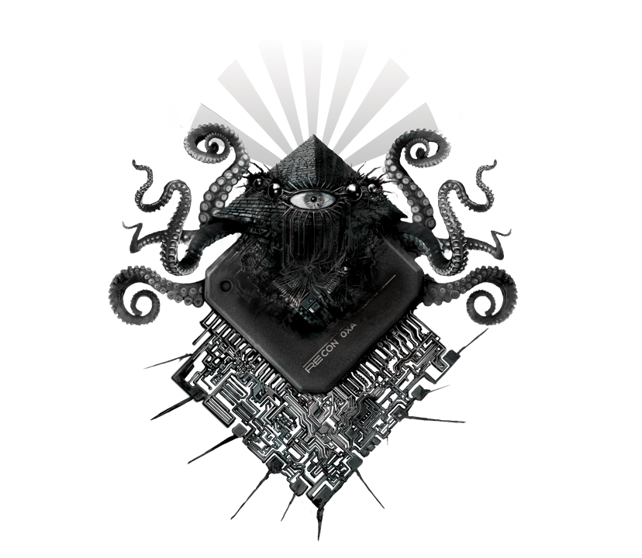

Memory Ranger history
MemoryRanger
with a new feature
Prevention of the FILE_OBJECT attack
MemoryRanger
AllMemPro
AllMemPro
MemoryMonRWX
MemoryMonRWX
MemoryMonRWX
HyperPlatform
HyperPlatform
HyperPlatform
HyperPlatform
Step 1
Step 2
Step 3
Step 4
Step 5
REcon
Korkin, I., & Tanda, S. (2016). Monitoring & controlling kernel-mode events by HyperPlatform. Recon, Canada.
Korkin, I., & Tanda, S. (2017). Detect Kernel-Mode Rootkits via Real Time Logging & Controlling Memory Access. ADFSL, USA.
Korkin, I. (2018). Hypervisor-Based Active Data Protection for Integrity and Confidentiality of Dynamically Allocated Memory in Windows Kernel. ADFSL, USA.
Korkin, I. (2018). Divide et Impera: MemoryRanger Runs Drivers in Isolated Kernel Spaces. BlackHat, UK
Korkin, I. (2019). MemoryRanger Prevents Hijacking FILE_OBJECT structures in Windows Kernel. ADFSL, USA.

